Slide 1
Student Management System
Developed By:
1.Pankaj Singh Kushwah(CSE)
2.Raj Kag (CSE)
3.Rohit Bajaj(CSE)

Slide 2
Introduction
Definition:
  It is a general “Student Management System (SMS)” which is a integrated by any system(such as. Coaching, Intititute,University,College,School etc .)that manages the records of student regarding admission , fee payment and internal assessments.
SMS involves
  Manage fees structure
  Alerts
  Fees payment
  Admission seat management
  Result management
  Manage new admission

Slide 3
Motivation
To overcome existing problems occurring in maintenance of students’ information
Most of the college and institute don’t provide such
type of facility because such type of application
are costly or some security issues.
Than we over come such type of issues and develop
a low cost system and provide better security by using (J2EE).

Slide 4
Objectives
To manage students’ information during admission fee and examination.
  Efficient utilization of human resource.
  To reduce unnecessary paper work in maintaining students’ information.

Slide 5
Applications
To use for various stream’s students.
(but in our system we use only one stream. which is engineering in which we have only two branches such as CSE,IT).
To gather students’ information.

Slide 6
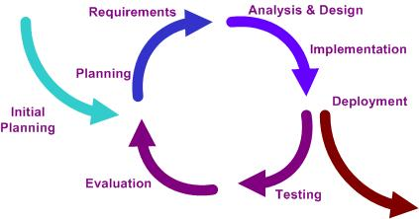
Methodology
Iterative and Incremental Life Cycle

Slide 7
Architecture of SMS
Data Layer
Database
Business Layer
Control Layer
Presentation Layer

Slide 8
Current system information
Current system is for sample purpose which is not related to any
institute
In this system we use admission department service for enroll the student.
In this system student user are register for engineering stream in one branch(such as CSE,IT)
Here admin play and important roll for providing regular college update by using alert notification system .
Admin is also able to update fee information of students.
Here faculty department is use to give attendance , internal assessment of particular student of particular branch.
Each branch have only 3 subject whose name is (a,b,c).

Slide 9
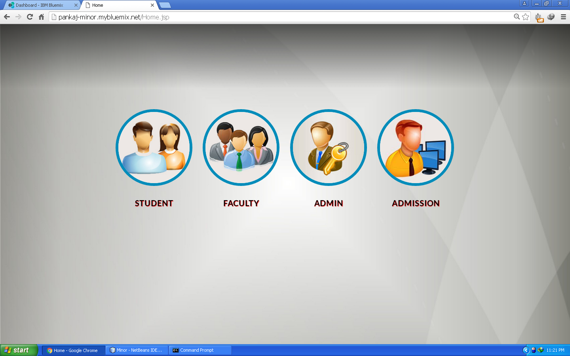
Screen Shot Showing Home

Slide 10
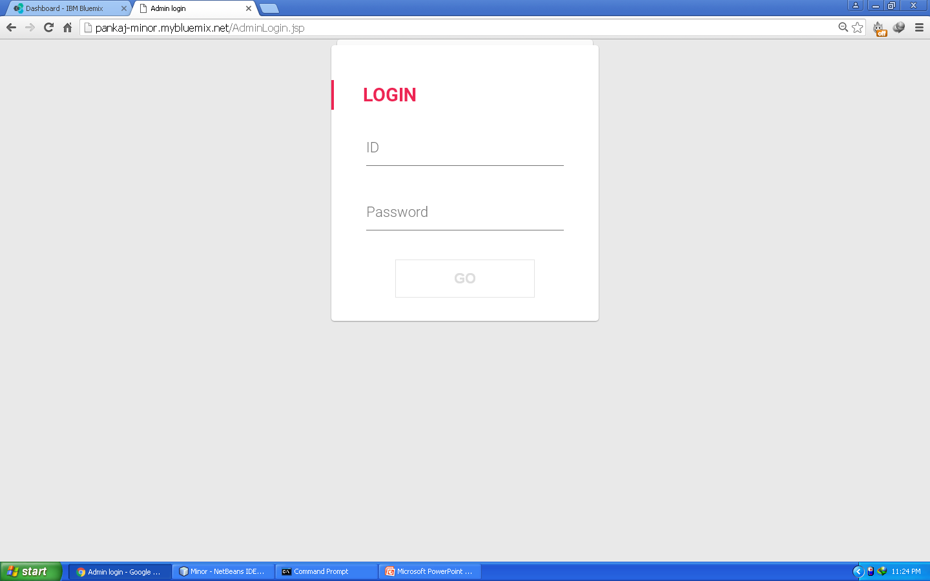
Screen Shot Showing Admission login

Slide 11
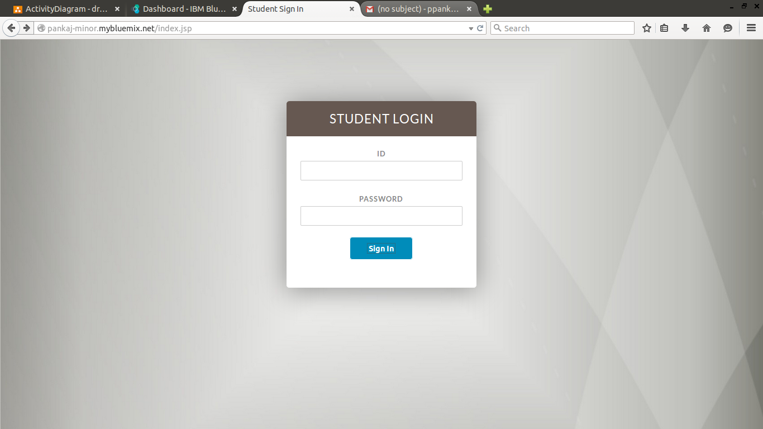
Screen Shot Showing Student login

Slide 12
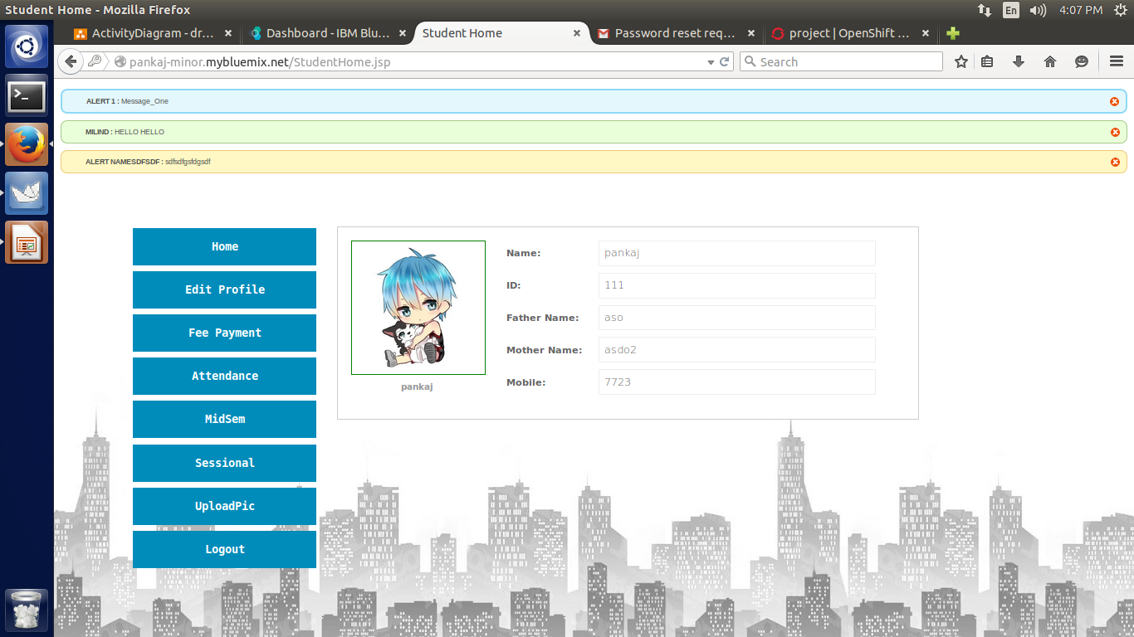
Screen Shot Showing Student Home

Slide 13
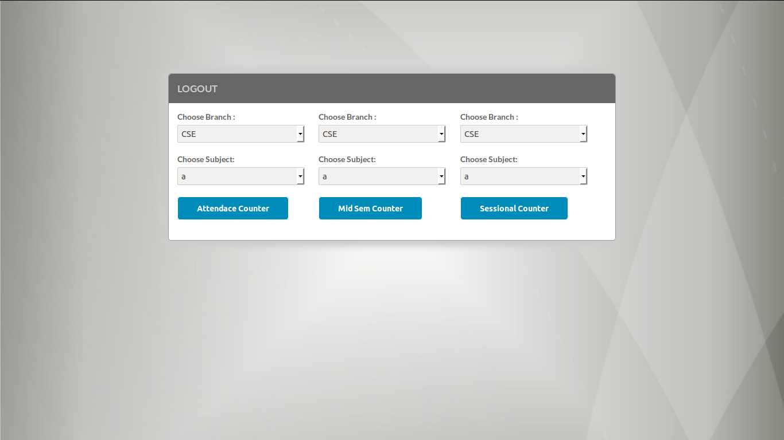
Screen Shot Showing Faculty Home

Slide 14
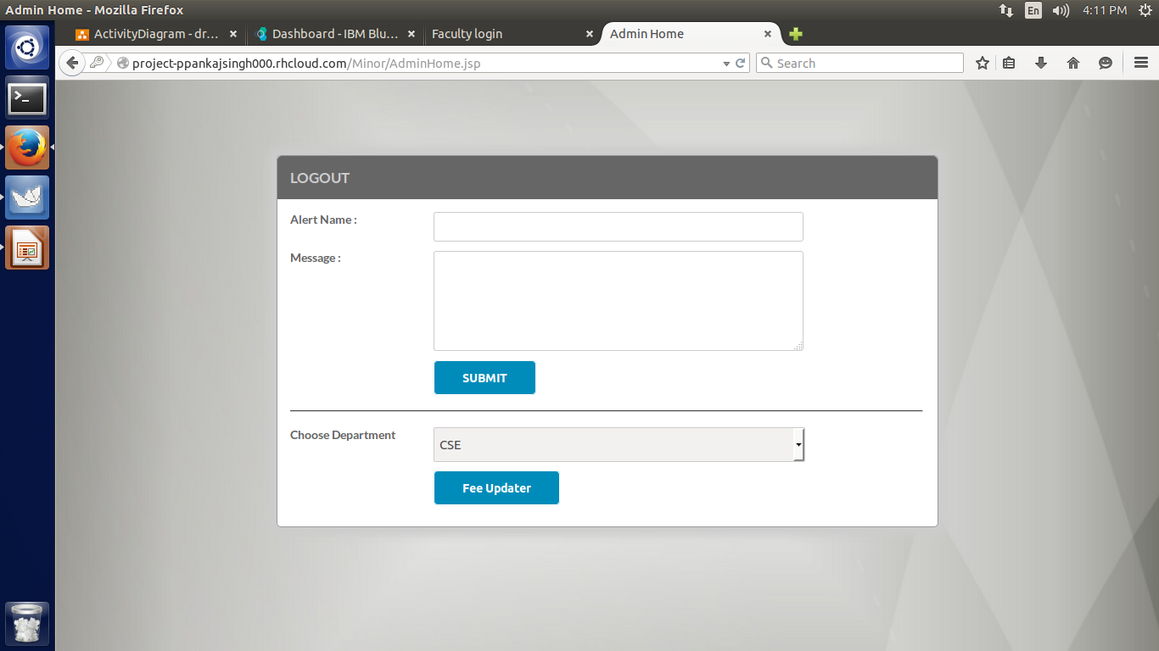
Screen Shot Showing Admin Home

Slide 15
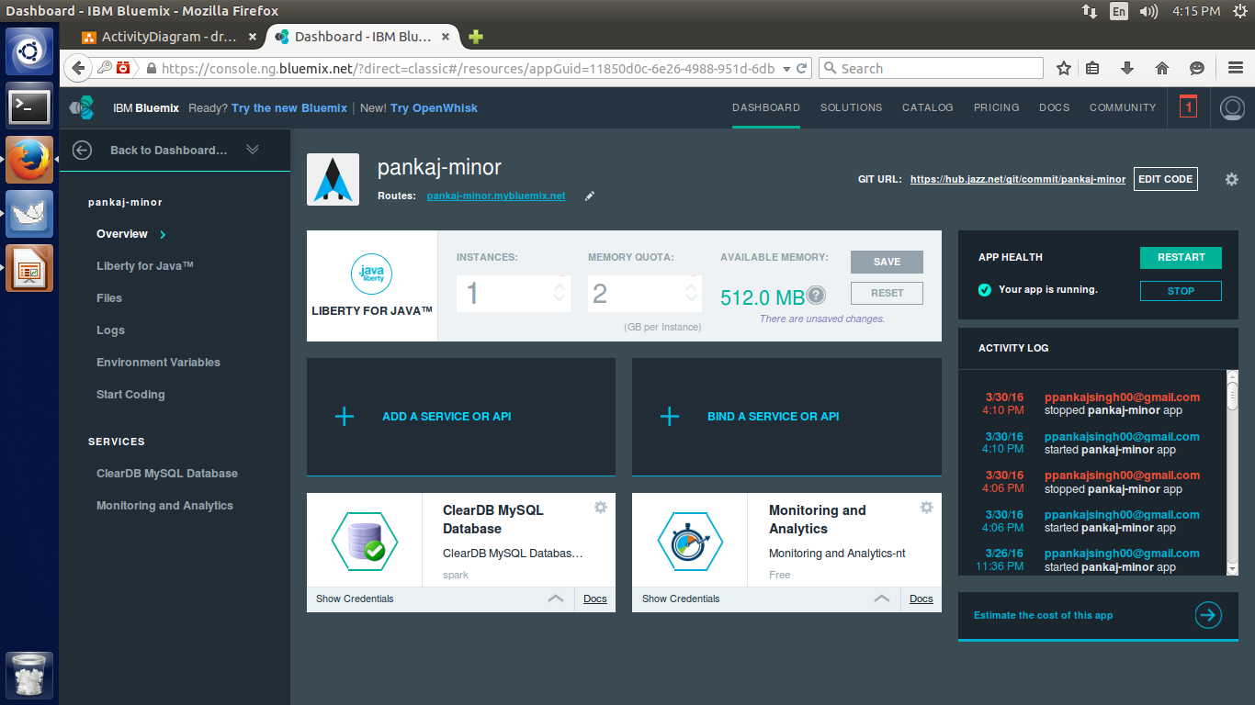
Screen Shot Showing BlueMix Project Home

Slide 16
Conclusion
helpful to perform paperless work and manage all data
provides easy, accurate, unambiguous and faster data access.

Slide 17


